Slide 1

University College of Engineering, Ariyalur.
Polarity of Hashtags Using Pattern Mining
Prepared by-
Dharani.R 814817104008
Keerthika.N 814817104017
Ganesamoorthy.S 814817104012
Project Guide - Dr.S.Jayanthi HOD\CSE

Slide 2
Topics Include
Abstract
Purpose and Scope
Issues and Challenges faced in Existing System
Proposed System
Tools & Languages Used
Conclusion
Literature survey
System Architecture
Modules

Slide 3
Abstract
Hash tag is an iconic feature to retrieve the hot topics of discussion on Twitter or other social networks.
In proposed project the implementation of frequent pattern(FP) growth algorithm to identify the frequently used hash tag.
We proposed a method to classify the polarity of tweets based on Pattern mining also predict the probability of decision.

Slide 4
Purpose
Review on currently published movies, songs and products are represented graphically.
To forecast the Business, politics and public options.
Scope
Social networking sites for determining opinions of people on products, brands or even a person

Slide 5
Literature Survey
S No | Title | Author | Year | Technique | Disadvantage | Advantage
1 | Retrieving information for micro blog using pattern mining and relevance feedback. | Cher Han Lau, Xiaohui Tao, Dian Tjondronegoro, Yue Feng. | 2018 | Micro Blog | Micro Blog is not Popular, And it has only 140 Character Limit | Twitter is used and its Character Limit is 280
2 | Mining frequent patterns without candidate generation | J.Han, J.Rei, Y.Yin. | 2019 | Apriori Algorithm | Apriori will scan database many times repeatedly for finding candidate item sets | FP-growth algorithm is much faster and efficient

Slide 6
S No | Title | Author | Year | Techniques | Disadvantages | advantages
3 | Sentiment Analysis of Twitter Data | Sahar A. El Rahman, Feddah Alhumaidi AlOtaibi, Wejdan Abdullah AlShehri. | 2019 | Support vector machine Algorithm | SVM algorithm is not suitable for large data sets. SVM does not perform very well when the data set has more noise. | Frequency pattern growth algorithm is suitable for large datasets
4 | Prediction of 2019 Indian Election Using Sentiment Analysis | Bharat R. Naiknaware Seema S. Kawathekar | 2019 | Access Twitter API |  | Used this for Twitter Developer Account and live data collection

Slide 7
S No | Title | Author | Year | Techniques | Disadvantages | Advantages
5 | Sentiment Analysis on Product Reviews | Rahul, Vasundhara Raj, Monika. | 2020 | Naive Bayes Algorithm | Naïve Bayes Algorithm requires Training. Prediction may go wrong due to lack of training | Text Blob is a Pre-Trained AI Module for NLP

Slide 8
S No | Title | Author | Year | Techniques | Disadvantages | Advantages
6 | Real-Time Sentiment Analysis of 2019 Election Tweets using Word2vec and Random Forest Model | MSR Hitesh, Vedhosi Vaibhav, Y.J Abhishek Kalki, Suraj Harsha Kamtam Santoshi Kumari | 2020 | Random forest for sentimental Classification | It requires much time for training as it combines a lot of decision trees to determine the class. | No Training Required because of Pre-Trained NLP Module

Slide 9
S No | Title | Author | Year | Techniques | Disadvantages | Advantages
7 | Sentiment Analysis in Social Media and Its Application: Systematic Literature Review | ZulfadzliDrus, HaliyanaKhalid | 2020 | TF-IDF (Term Frequency-Inverse Document Frequency) | This technique computes document similarity directly in the word-count space, hence making it really slow for large documents. | Frequent Pattern Growth Algorithm is faster even for a large dataset.

Slide 10
Issues and Challenges Faced in Existing System
Many Social Media networks like Twitter, Instagram does not able to find how many people support or against the post of any tweets by using Hashtags(#). For Example, #FarmerProtest100Days and #SpeakUpAgainstPriceRise.
But some people posting negative comment (or) feedback on some public figures in social media that projects the
Particular figure in negative
Manner.
Support
Post
Against

Slide 11
Proposed System
This project is used to seperate the Supporters and Haters who against the tweets by using frequent pattern growth algorithm and natural language processing.
In frequent pattern growth algorithm there is no candidate generation.
It constructs conditional, frequent pattern tree and conditional pattern base from database
The frequent item set are represented in tree format and it scan the database only twice.
Tree structure maintain association
rule between the item set.
Supporters
Tweets
Haters

Slide 12
Cont..
With this frequent pattern growth algorithm search for frequent item set is reduced comparatively.
This algorithm is efficient and scalable for mining long and short frequent patterns.
Pre-Trained NLP Module
The natural language processing are used to identify the text as positive, neutral or negative.
Which deals with the interaction between computers and human using the natural language.
To identify original frequency of tags and finding meaning of tags.

Slide 13




Tools and Languages used
Python 3.8.2
Tweetbot
API
CSV Dataset

Slide 14
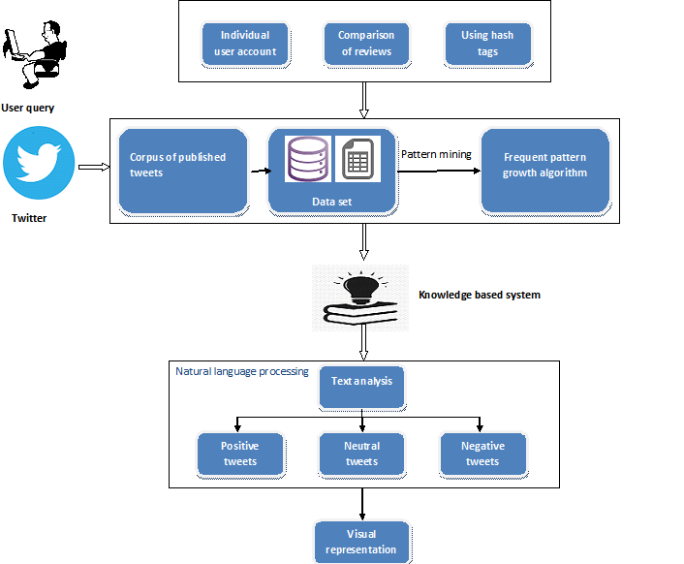
System Architecture

Slide 15
Module Separation
GUI
Twitter Developer login
Data Collection
Cleanup Tweets
Natural Language Processing
Decision

Slide 16

Module Specifications
GUI
Tkinter is a GUI Toolkit for creating User friendly Interfaces.
Fast Simple and reliable.
It’s a cross platform toolkit which supports windows, mac and Linux.
Here we are using GUI toolkit for getting user queries.

Slide 17

Module Specifications
Twitter Developer login
The first step for this project is to apply for a twitter developer account.
Twitter will provide a unique access token and access token secret key using this keys.
These keys can be used for the API Authentication

Slide 18

Module Specifications
Data Collection:
After authentication, we can either collect tweets by a particular user or by a hashtag by using the TweetPy Module
Then the captured content are stored together as dataset.
The datasets are text file saved as table structured format called CSV(comma separated values) file.
The frequent items in dataset are separated by using FP-Growth algorithm.

Slide 19
Module Specifications
Cleanup Tweets:
For getting better result in Natural language processing, we need to clean tweets
Remove Links
Remove Hashtags
Remove Retweets
Remove URL’s
Spelling correction
Grammatical Error Correction

Slide 20

Module Specifications
Natural Language Processing:
NLP(Natural Language Processing) is used to classify the data from tweets.
Text Blob is simplified Text processing Module
Classification is the process of identifying opinions in text and labelling them as positive, negative, or neutral based on the tweets.
It can also give score for each tweet on a scale of -1 to 1

Slide 21
Applications
Process of determining whether the tweets are positive or negative
To determine the emotional tone behind the series of word.
Representation of result in pie-chart, bar graph and scatter plot.

Slide 22
Advantages
To Find Supporters and Haters for the post.
Separate Hashtags from Description by using Natural Language Processing.

Slide 23
Conclusion:
Aimed to determine opinion of people.
About large number of dataset(positive and negative) was collected.
Normalization of dataset was done.
A simple user interface was designed.
Representation of decision.

Slide 24
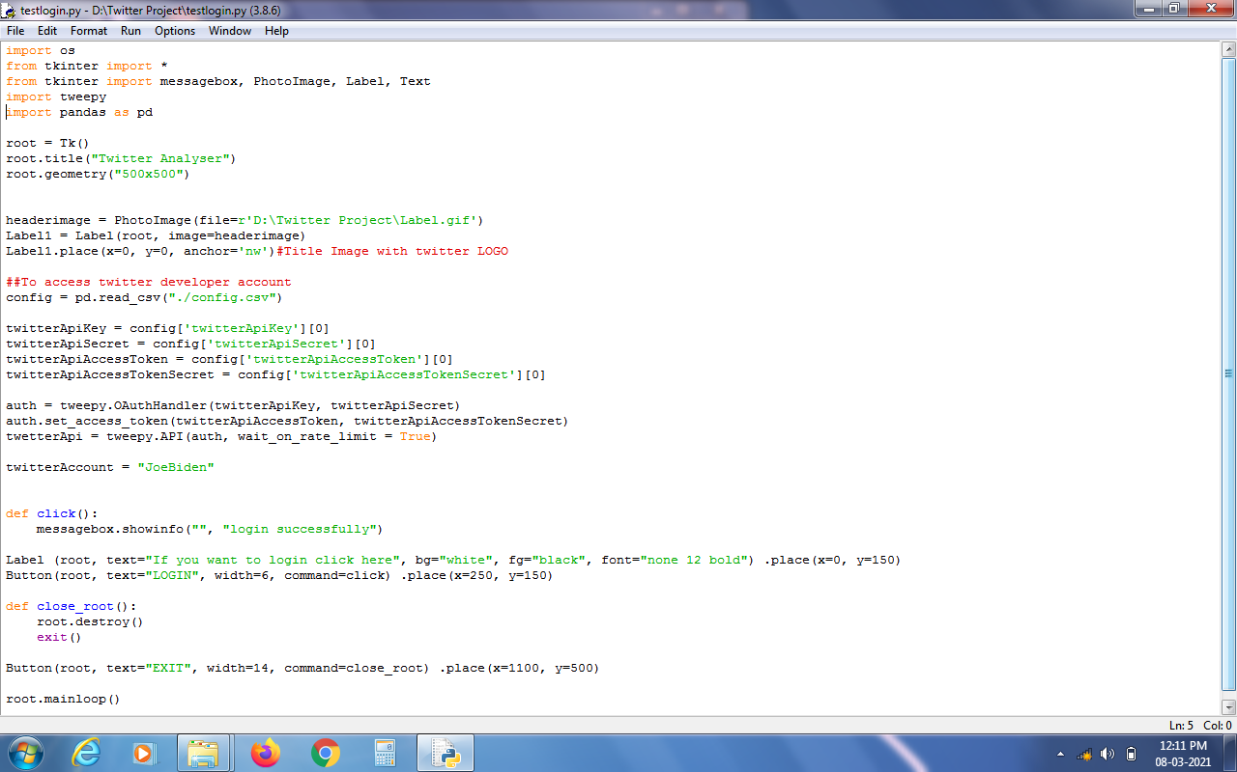
Login source code

Slide 25
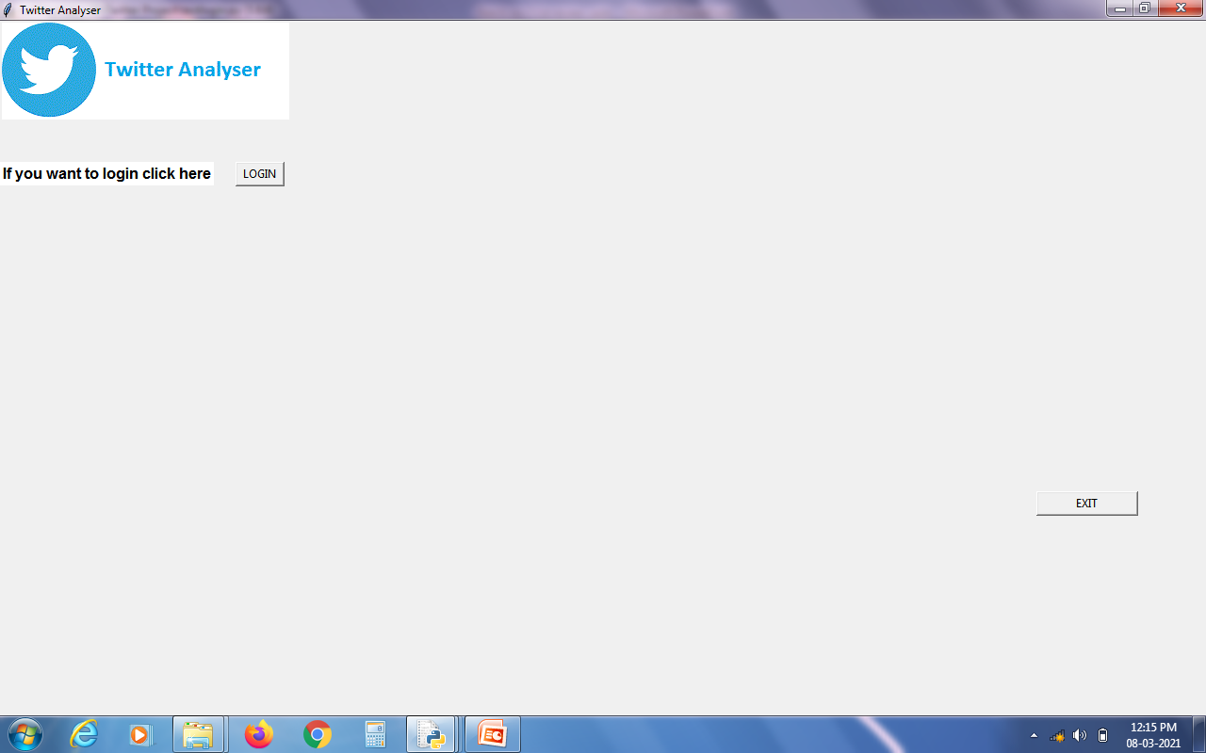
Output login

Slide 26
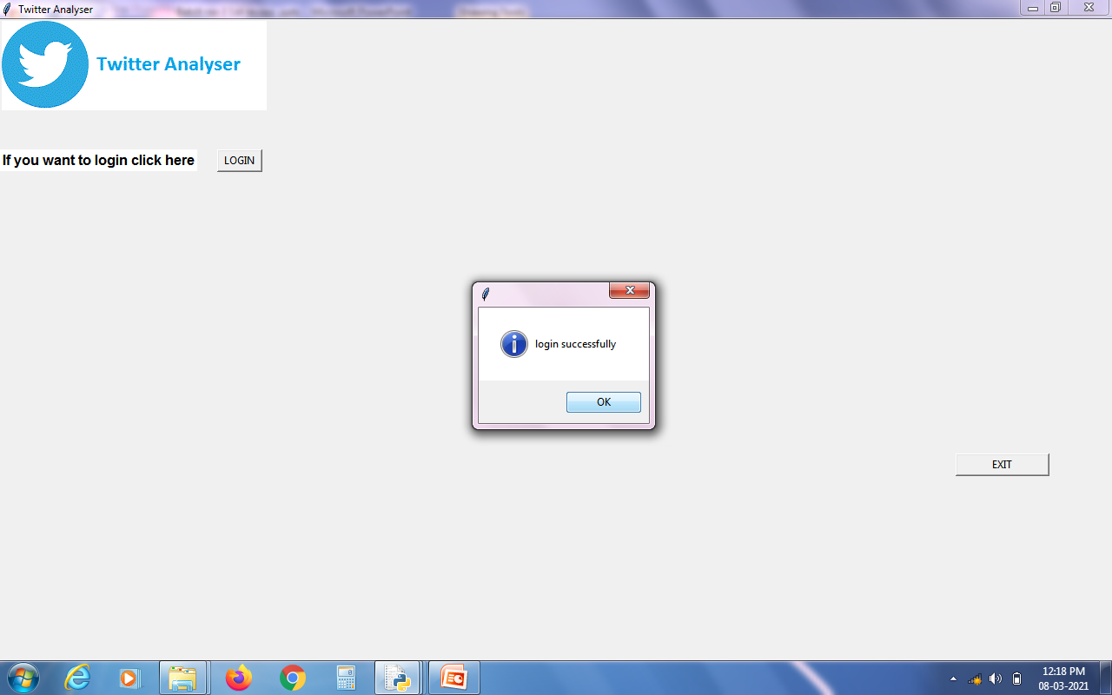

Slide 27
Reference
[1] Asma Belhadi, Youcef Djenouri, Jerry Chun-Wei Lin, Chongsheng Zhang, Alberto Cano, “Exploring Pattern Mining Algorithms for Hashtag Retrieval Problem”, 2020.
[2] Y. Gong, Q. Zhang, and X. Huang, ``Hashtag recommendation for multimodal microblog posts,'' Neurocomputing, vol. 272, pp. 170177, Jan. 2018.
[3] G. G. Chowdhury, Introduction to Modern Information Retrieval. Facet Publishing, 2010.
[4] M. Efron, ``Hashtag retrieval in a microblogging environment,'' in Proc. 33rd Int. ACM SIGIR Conf. Res. Develop. Inf. Retr., 2010, pp. 787788.

Slide 28
Reference
[5] Cher Han Lau, Xiaohui Tao, Dian Tjondronegoro, Yue Feng. “Retrieving information for micro blog using pattern mining and relevance feedback”, 2018.
[6] J.Han, J.Rei, Y.Yin. “Mining frequent patterns without candidate generation”, 2019.
[7] Sahar A. El Rahman, Feddah Alhumaidi AlOtaibi, Wejdan Abdullah AlShehri. “Sentiment Analysis of Twitter Data”, 2019.
[8] Bharat R. Naiknaware, Seema S. Kawathekar, “Prediction of 2019 Indian Election Using Sentiment Analysis”, 2019.
[9] ZulfadzliDrus, HaliyanaKhalid, “Sentiment Analysis in Social Media and Its Application: Systematic Literature Review”, 2020.
[10] H. K. Azad and A. Deepak, "Query expansion techniques for information retrieval: A survey", Inf. Process. Manage., vol. 56, no. 5, pp. 1698-1735, Sep. 2019.

